Slide 1

EEET2449 Research Methods for Engineers
Lecture 5: Practicing ‘Literature Review’ – Part 2
Dr. Francisco Tovar
Francisco.tovarlopez@rmit.edu.au

Slide 2
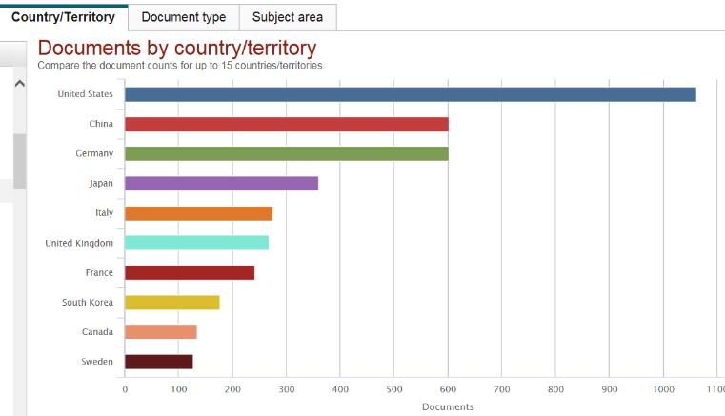
Part 1: A few useful search engines for scientific papers
Over the last 4 weeks, we have used Web of Science to find articles.
Today we will learn a new engine: Scopus
and discover some of its unique functions and visual features.
RMIT University© 2019
francisco.tovarlopez@rmit.edu.au

Slide 3
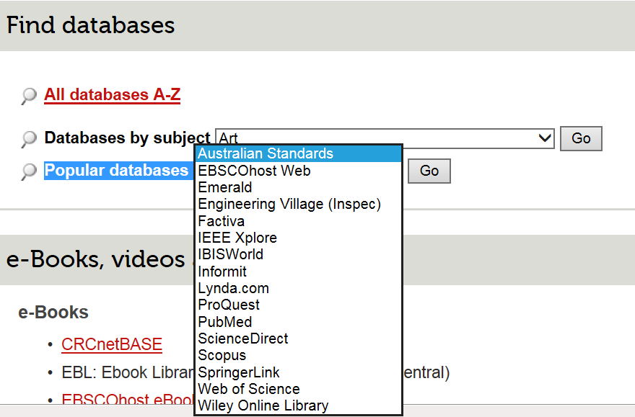
How to access?
http://www1.rmit.edu.au/library
Databases A-Z
Popular databases
RMIT University© 2019
francisco.tovarlopez@rmit.edu.au

Slide 4
How to access?
This might help you to access the papers from home
RMIT University© 2019
francisco.tovarlopez@rmit.edu.au

Slide 5
Part 2: Let’s use SCOPUS for finding papers
https://www.scopus.com/
RMIT University© 2019
francisco.tovarlopez@rmit.edu.au

Slide 6
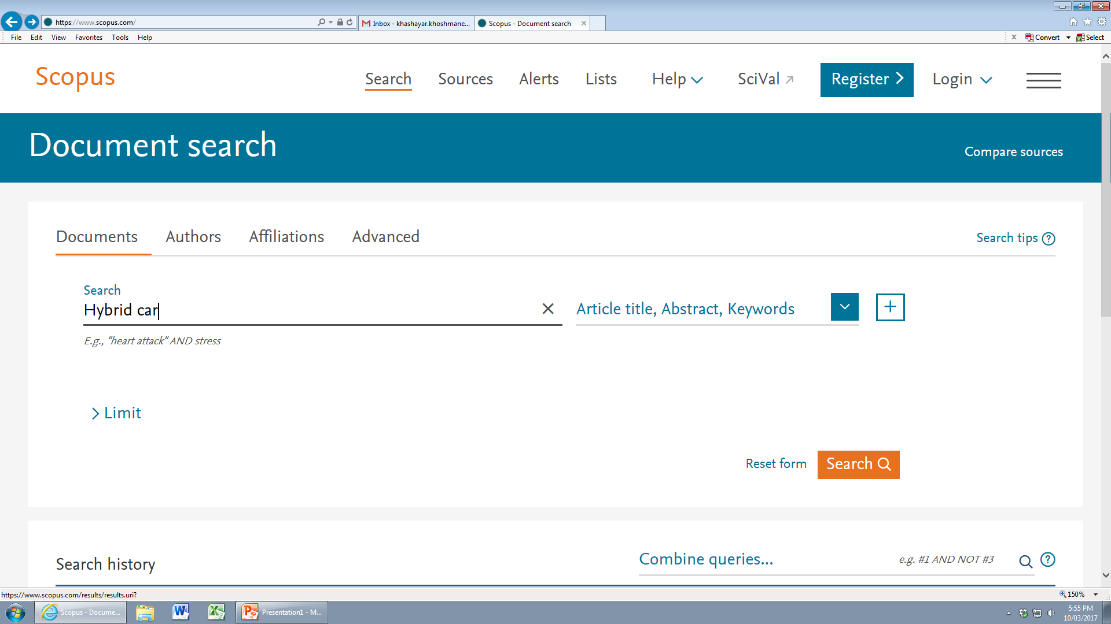
Let’s use SCOPUS for finding papers
Assuming that your research topic is hybrid cars……
RMIT University© 2019
francisco.tovarlopez@rmit.edu.au
6

Slide 7
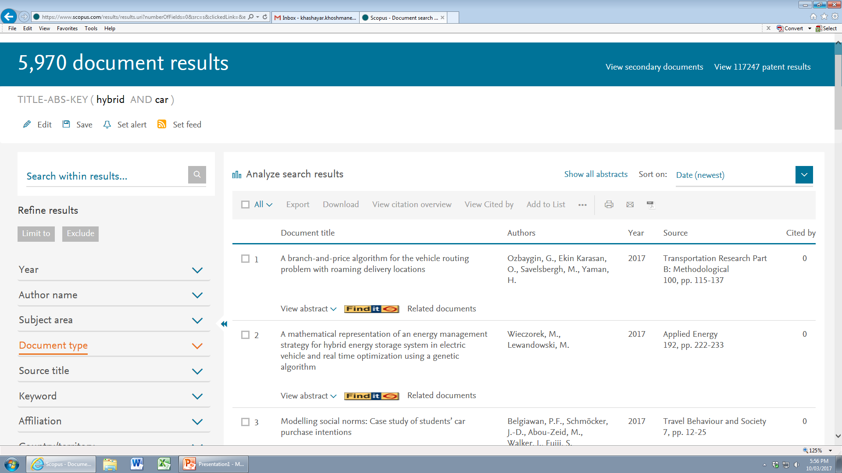
Let’s use SCOPUS for finding papers
Wow!
5970 papers are found !
Let’s narrow down our search
RMIT University© 2019
francisco.tovarlopez@rmit.edu.au

Slide 8
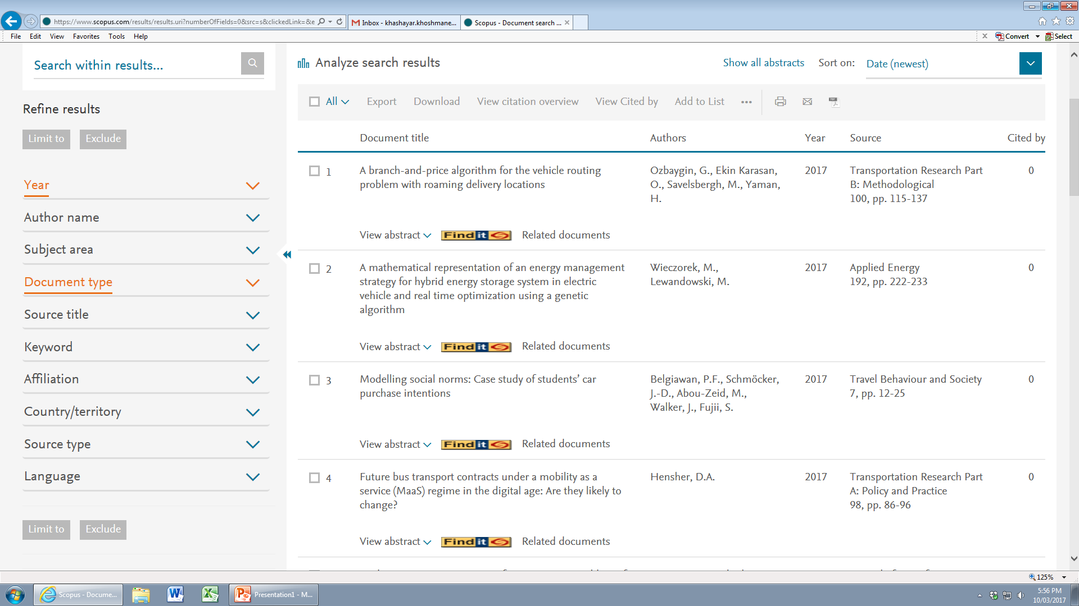
Let’s use SCOPUS for finding papers
Let’s have a look at the left box,
Where you find some ways to refine your search
RMIT University© 2019
francisco.tovarlopez@rmit.edu.au

Slide 9
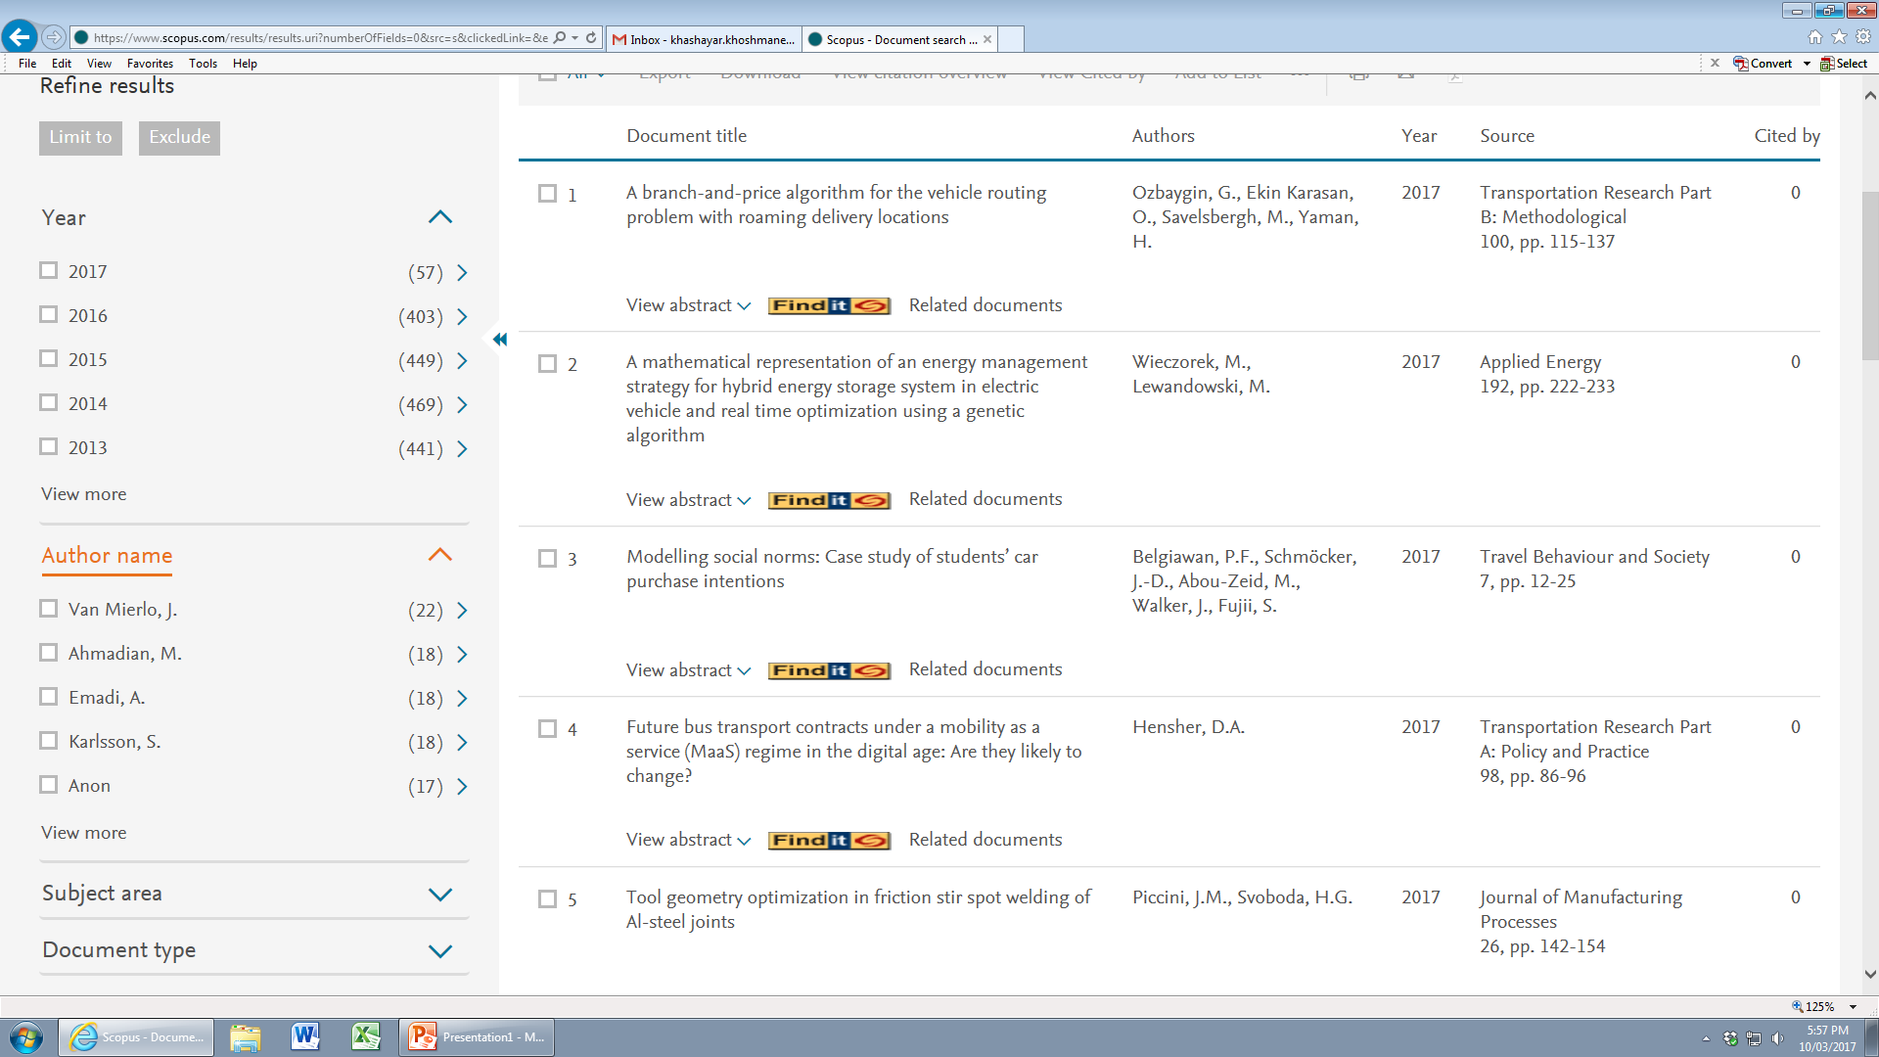
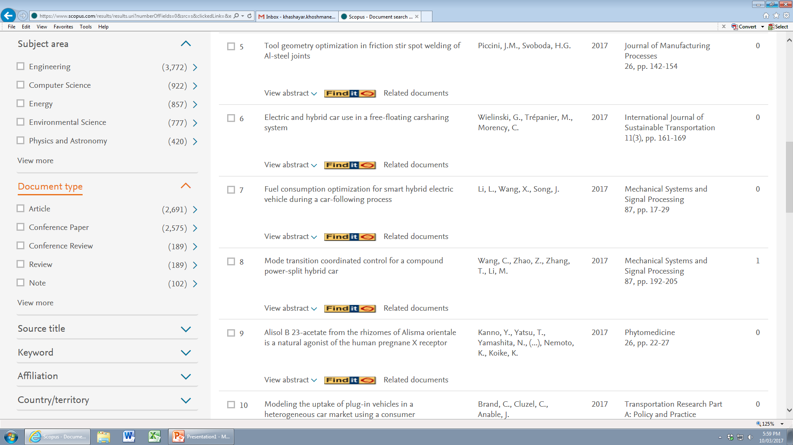
Let’s use SCOPUS for finding papers
This includes:
RMIT University© 2019
francisco.tovarlopez@rmit.edu.au

Slide 10
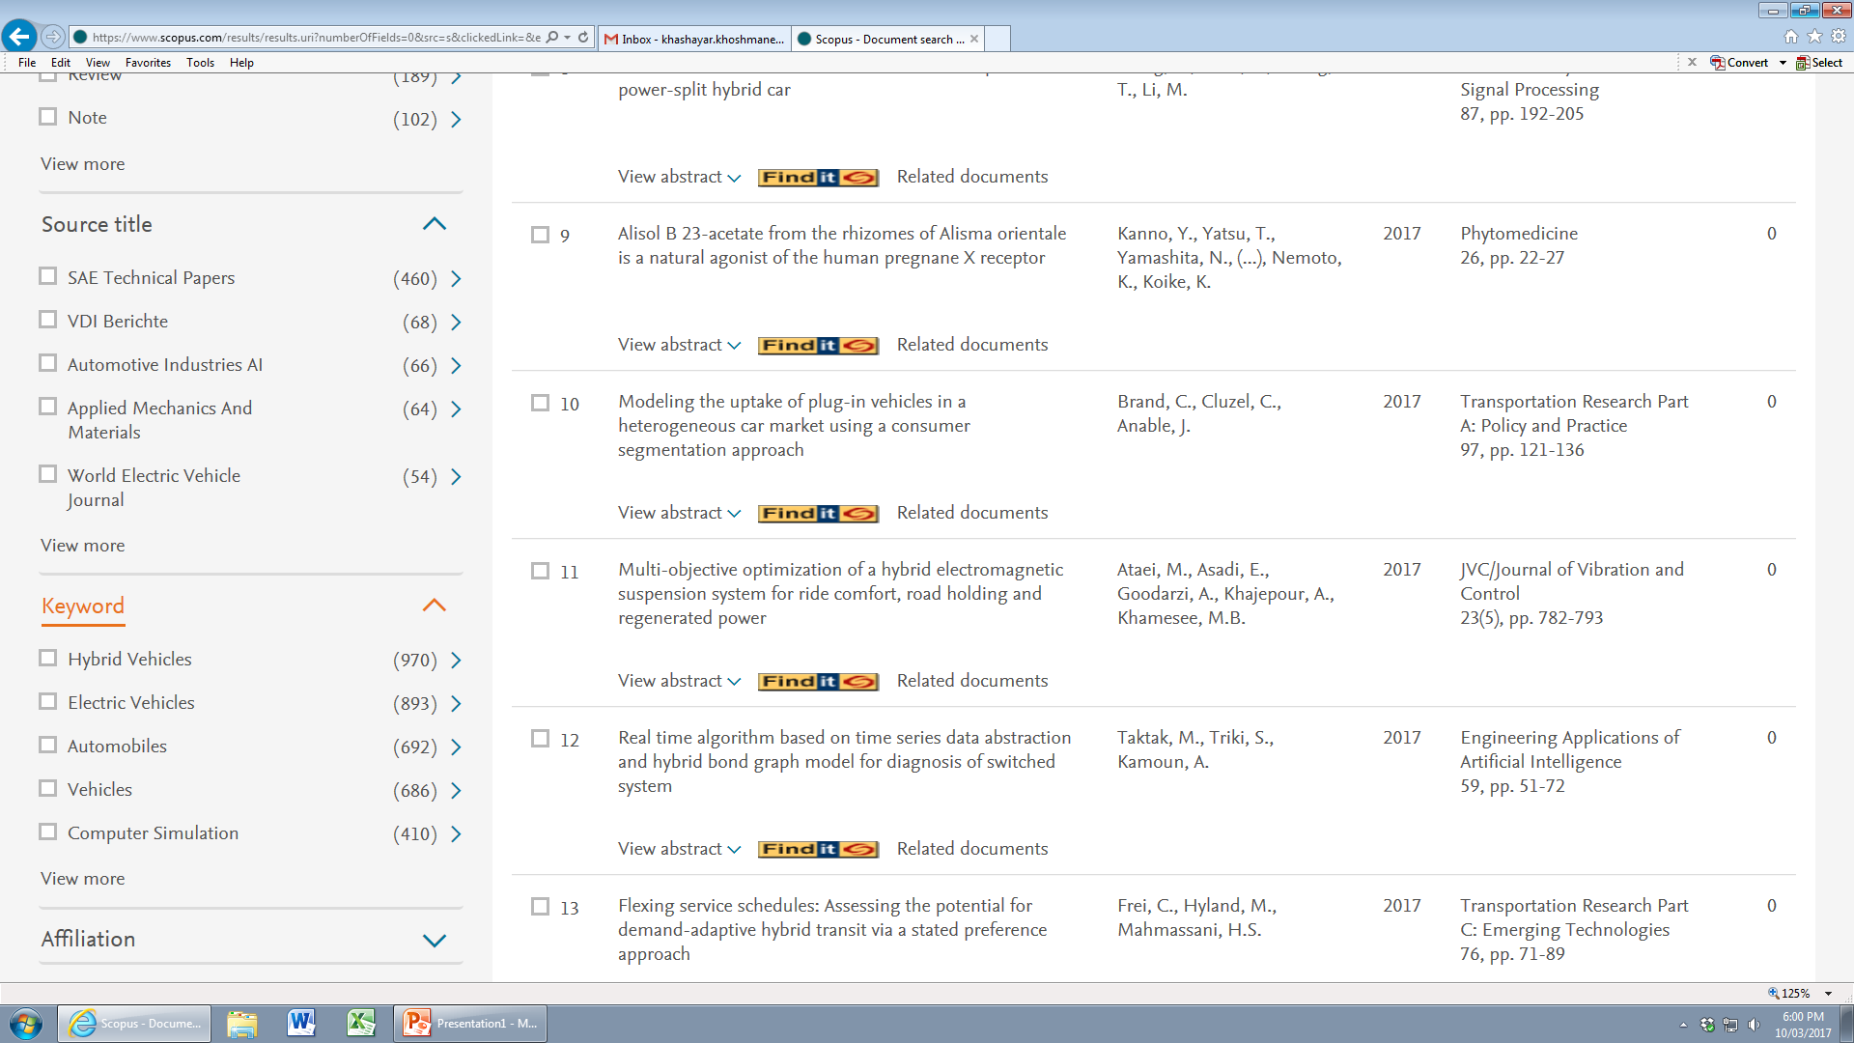
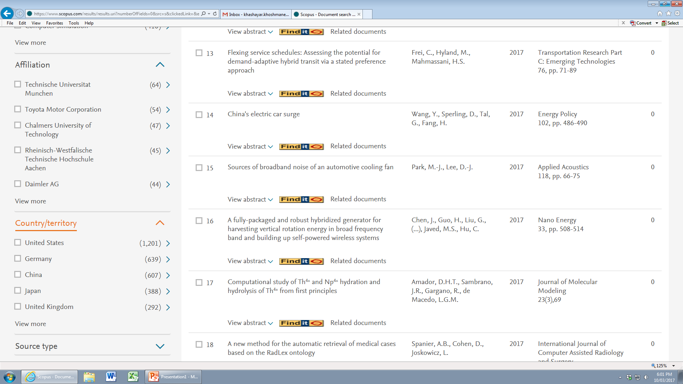
Let’s use SCOPUS for finding papers
This includes:
RMIT University© 2019
francisco.tovarlopez@rmit.edu.au

Slide 11
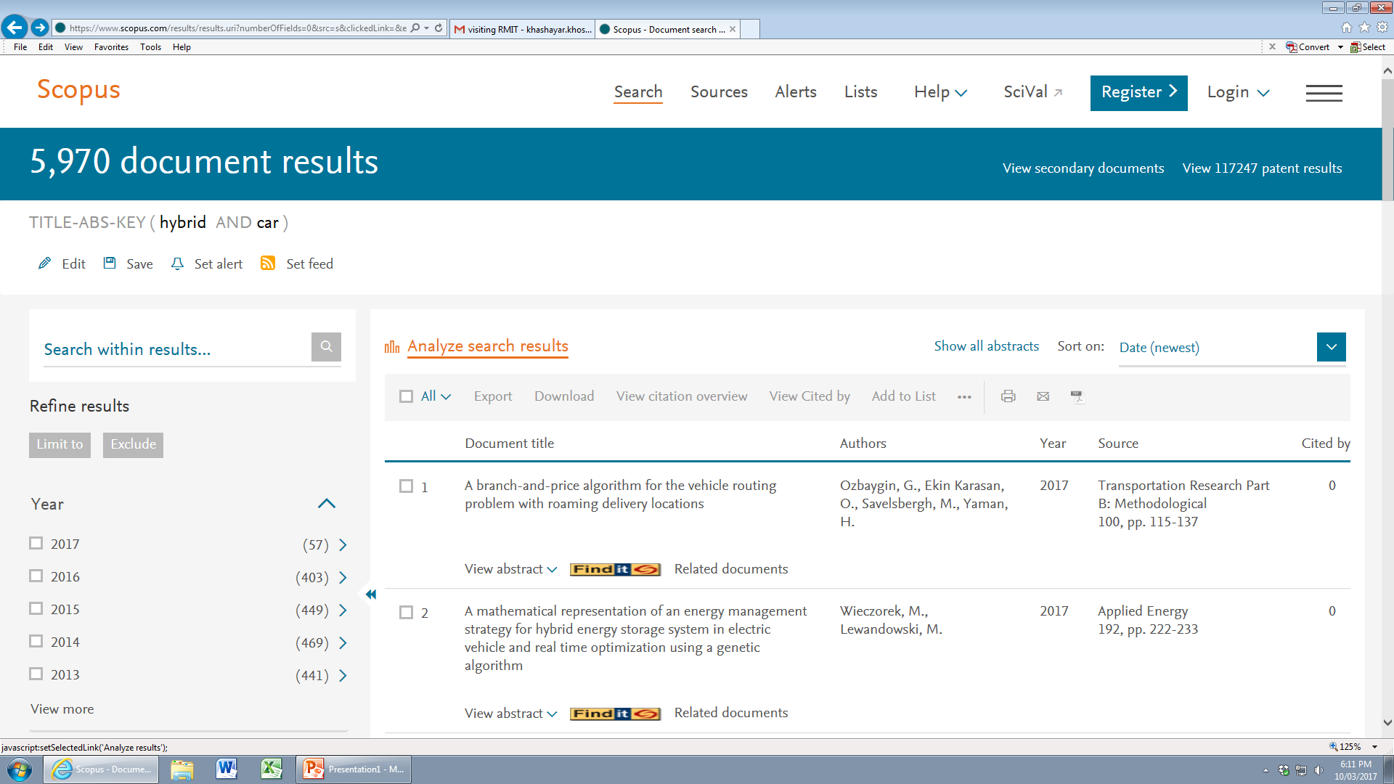
Let’s use SCOPUS for finding papers
Let’s have a look at the
‘Analyse search results’ box
RMIT University© 2019
francisco.tovarlopez@rmit.edu.au

Slide 12
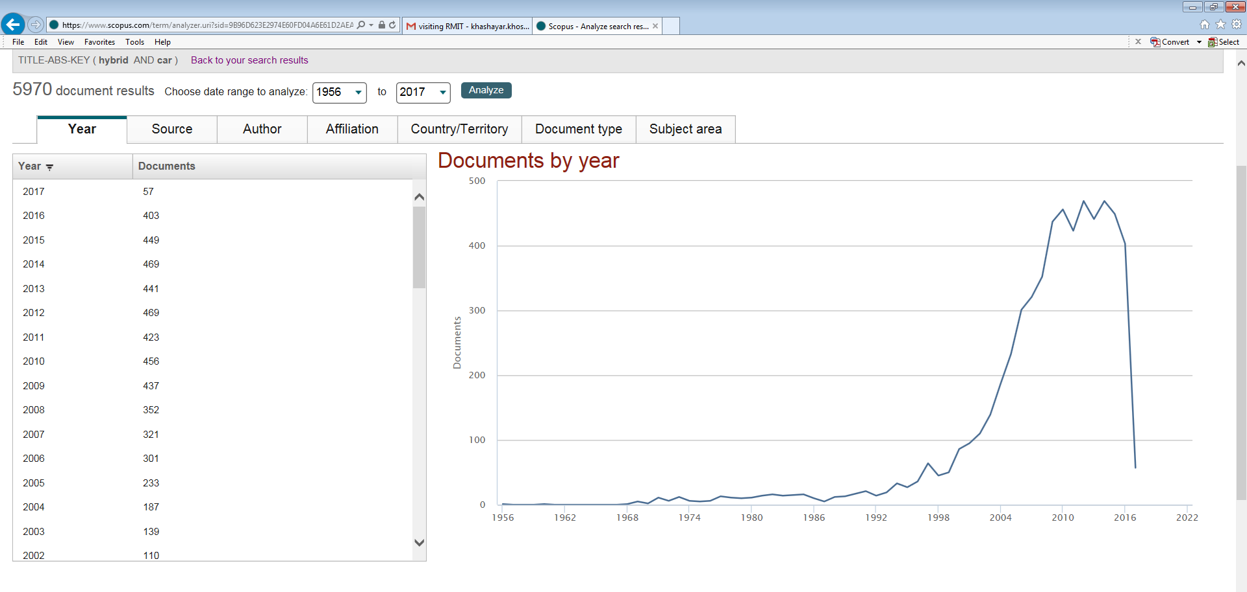
Let’s use SCOPUS for finding papers
You can see the trend of research
RMIT University© 2019
francisco.tovarlopez@rmit.edu.au

Slide 13
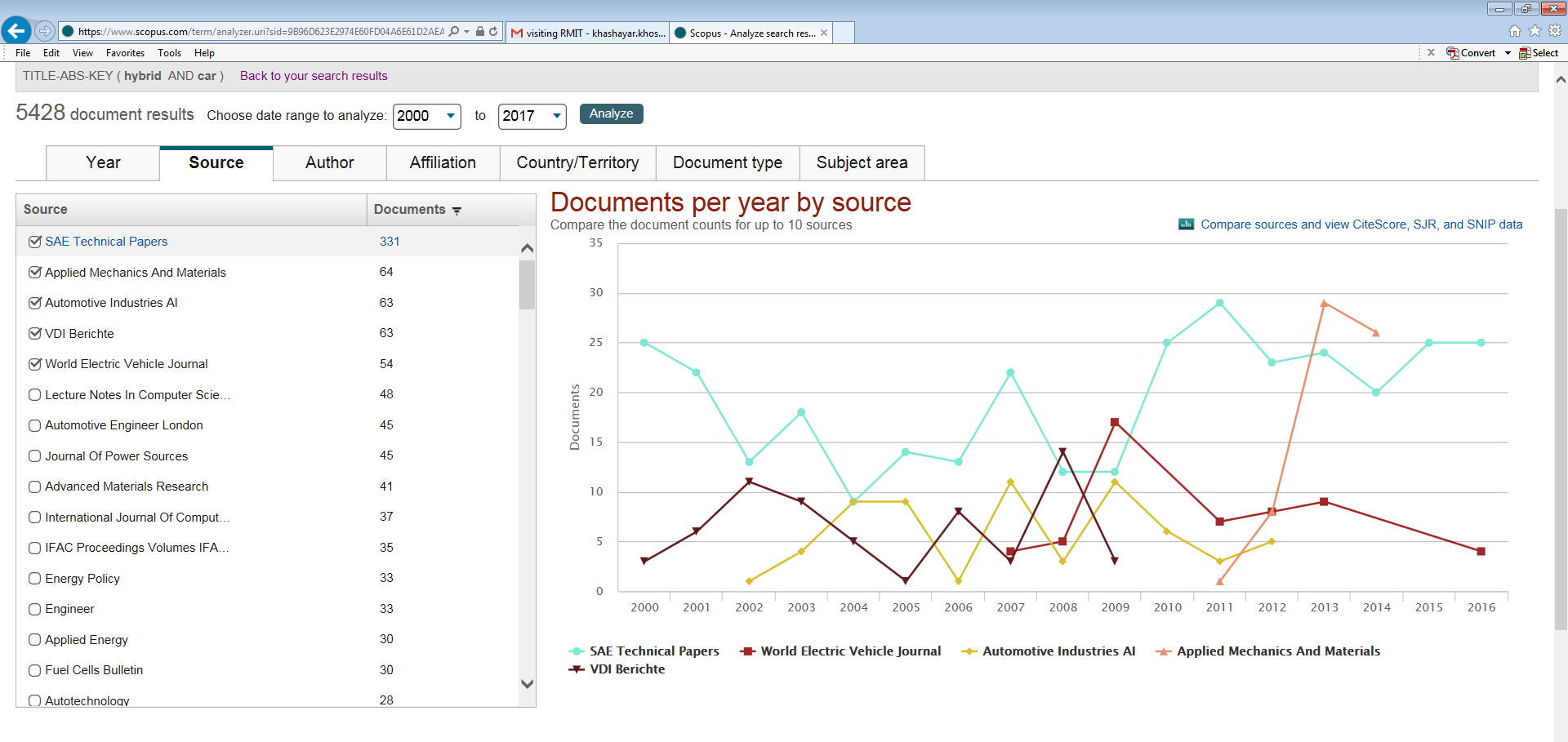
Let’s use SCOPUS for finding papers
You can find the top five journals in this field
RMIT University© 2019
francisco.tovarlopez@rmit.edu.au

Slide 14
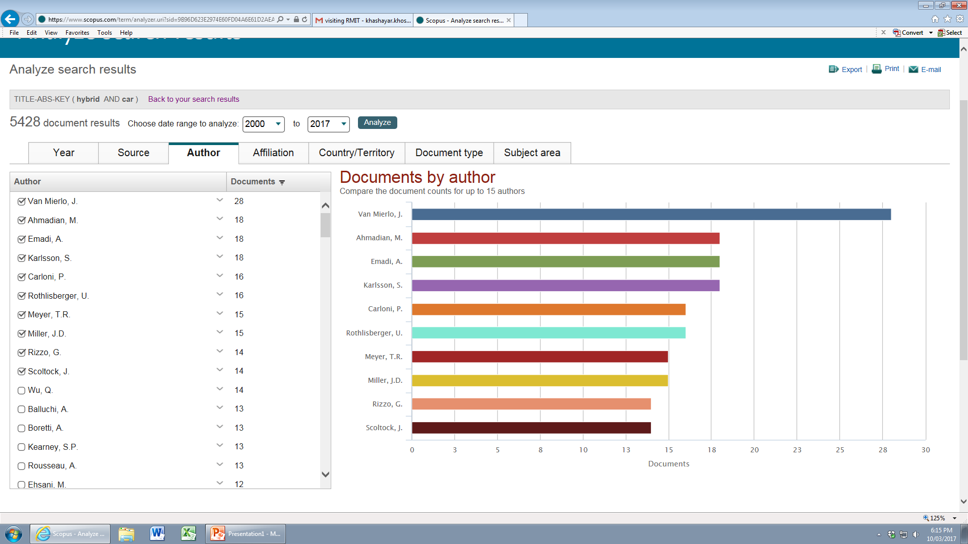
Let’s use SCOPUS for finding papers
You can find the top ten researchers in this field
RMIT University© 2019
francisco.tovarlopez@rmit.edu.au

Slide 15
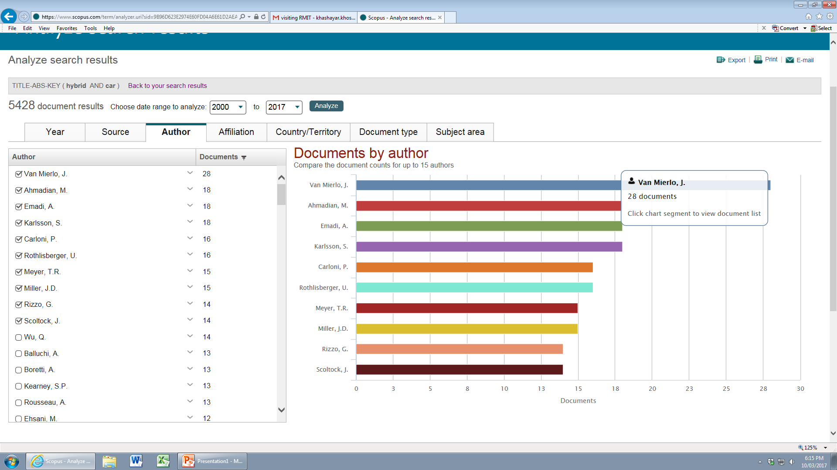
Let’s use SCOPUS for finding papers
You can go through the publications of your favourite author
RMIT University© 2019
francisco.tovarlopez@rmit.edu.au

Slide 16
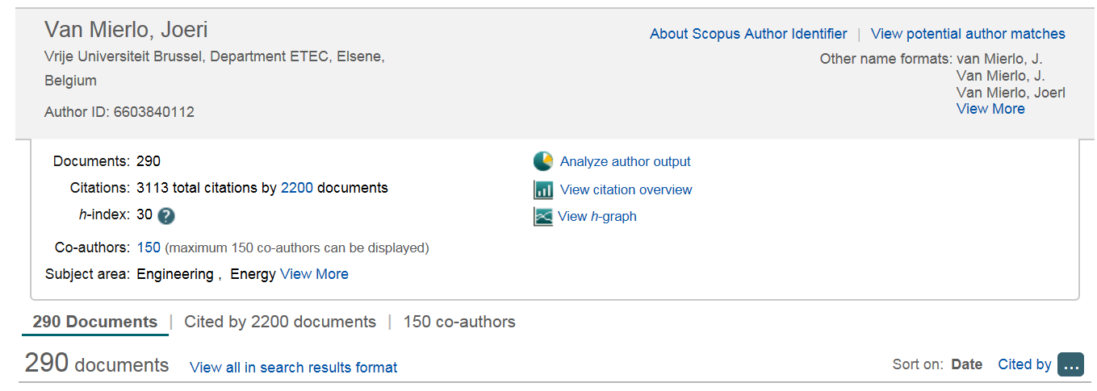
Let’s use SCOPUS for finding papers
For example, let’s go through the profiles of Van Mierlo, Joeri
RMIT University© 2019
francisco.tovarlopez@rmit.edu.au

Slide 17
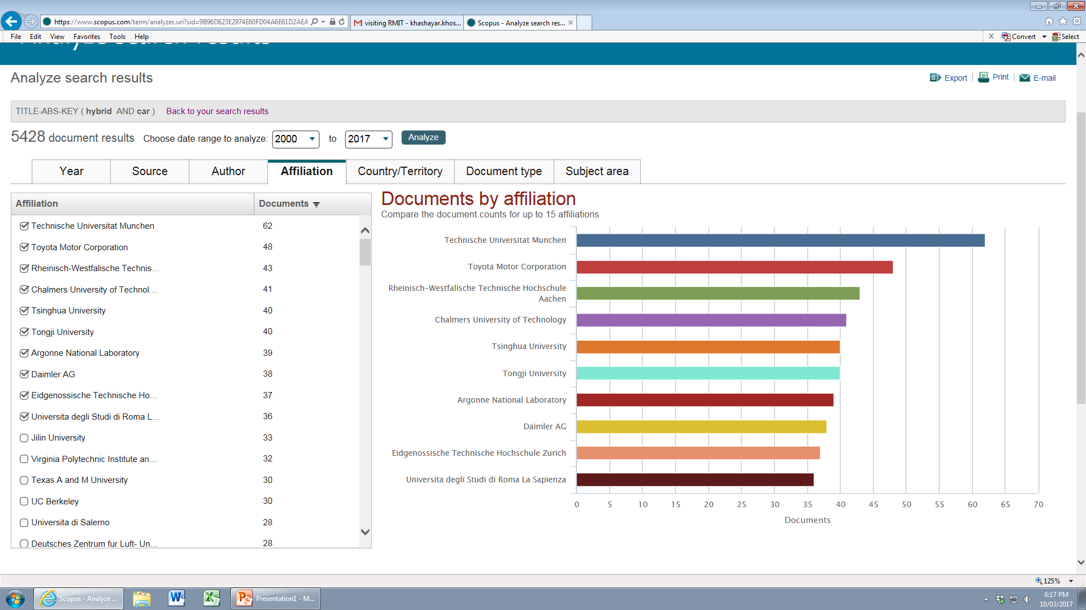
Let’s use SCOPUS for finding papers
You can find the top ten institutions in this field
RMIT University© 2019
francisco.tovarlopez@rmit.edu.au

Slide 18
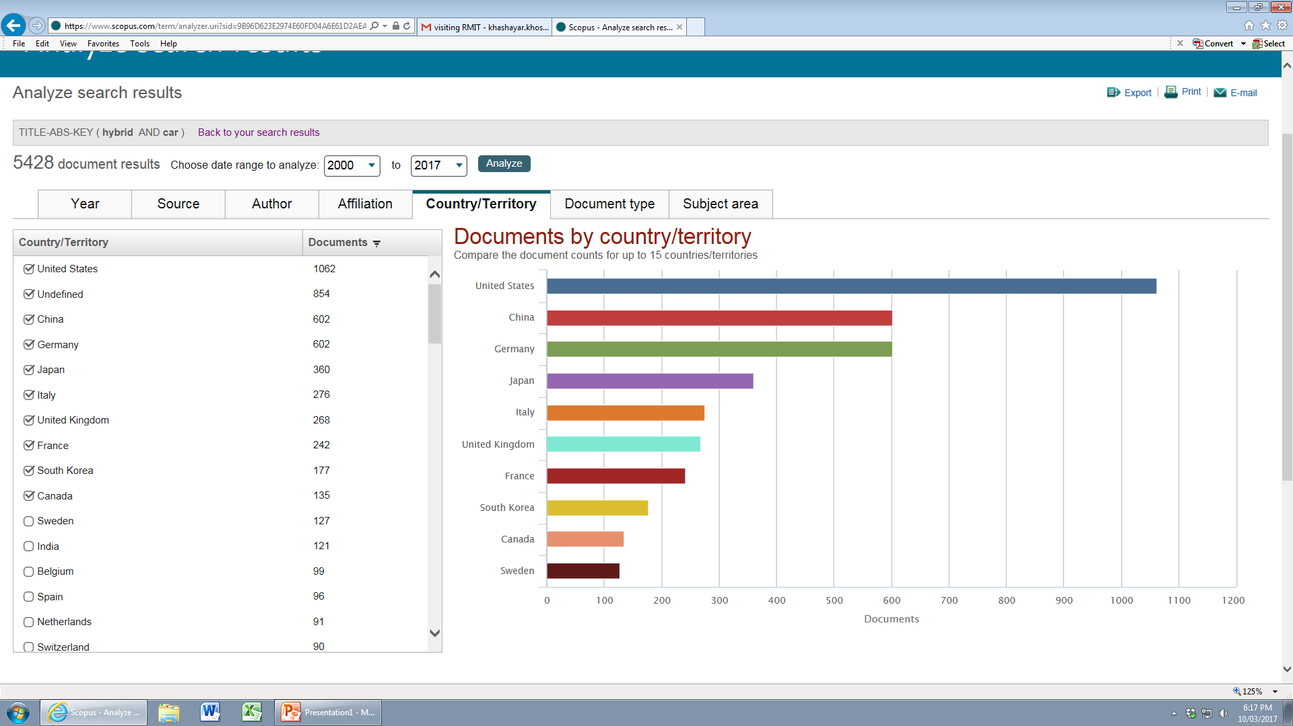
Let’s use SCOPUS for finding papers
You can find the top ten countries investing in this field
RMIT University© 2019
francisco.tovarlopez@rmit.edu.au

Slide 19

Let’s use SCOPUS for finding papers
Here it is ☺
RMIT University© 2019
francisco.tovarlopez@rmit.edu.au

Slide 20
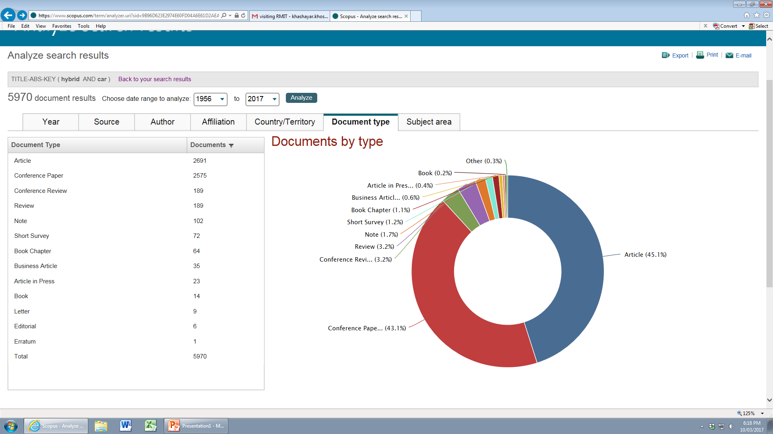
Let’s use SCOPUS for finding papers
You can find the ways you can publish or find information in this field
RMIT University© 2019
francisco.tovarlopez@rmit.edu.au

Slide 21
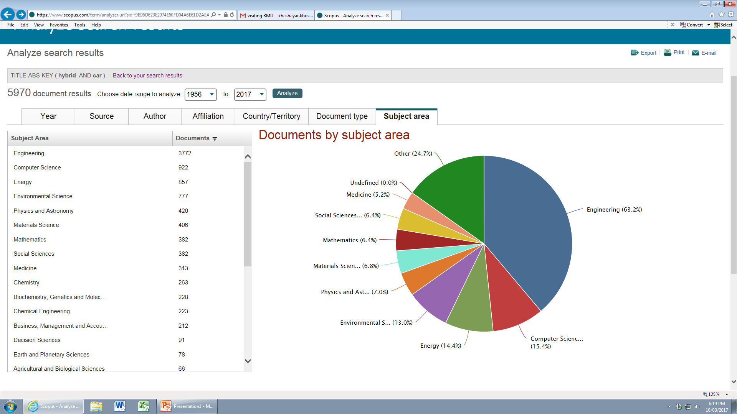
Let’s use SCOPUS for finding papers
You can find how you can connect yourself to this field
RMIT University©March 2017

Slide 22
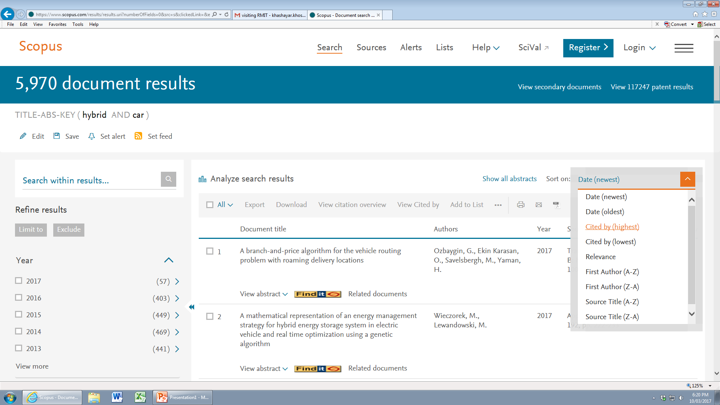
Let’s use SCOPUS for finding papers
You can also sort the papers as you wish
RMIT University© 2019
francisco.tovarlopez@rmit.edu.au

Slide 23
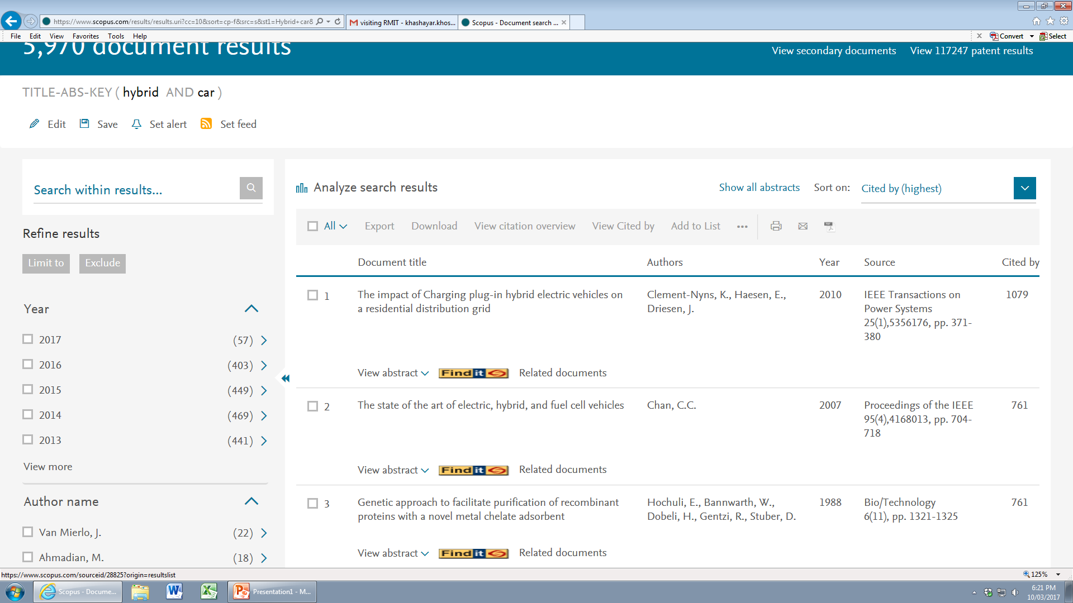
Let’s use SCOPUS for finding papers
For example according to the number of citations
RMIT University© 2019
francisco.tovarlopez@rmit.edu.au

Slide 24
Let’s exercise using Scopus ….
RMIT University© 2019
francisco.tovarlopez@rmit.edu.au

Slide 25
Part 3: Let’s take a look at Google Scholar
scholar.google.com.au/citations
RMIT University© 2019
francisco.tovarlopez@rmit.edu.au

Slide 26
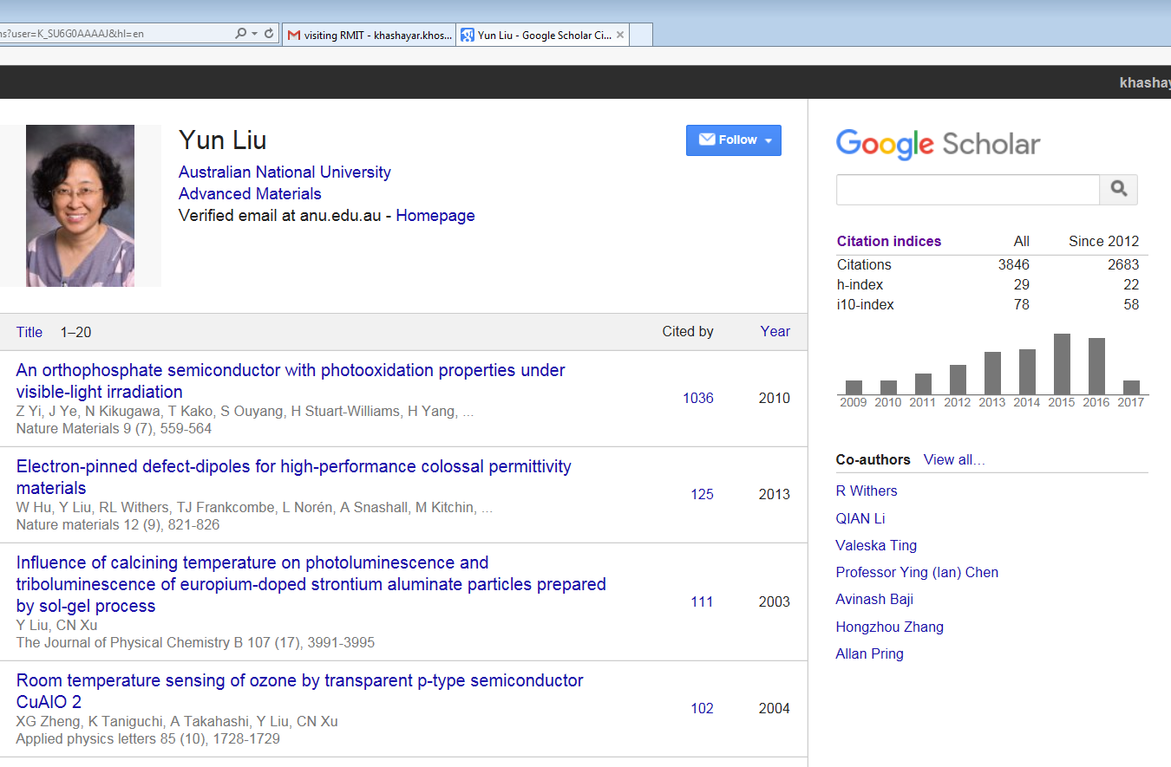
Let’s take a look at Google Scholar
You can find researchers based on their fields, see the number of their publications, citations, …
RMIT University© 2019
francisco.tovarlopez@rmit.edu.au

Slide 27
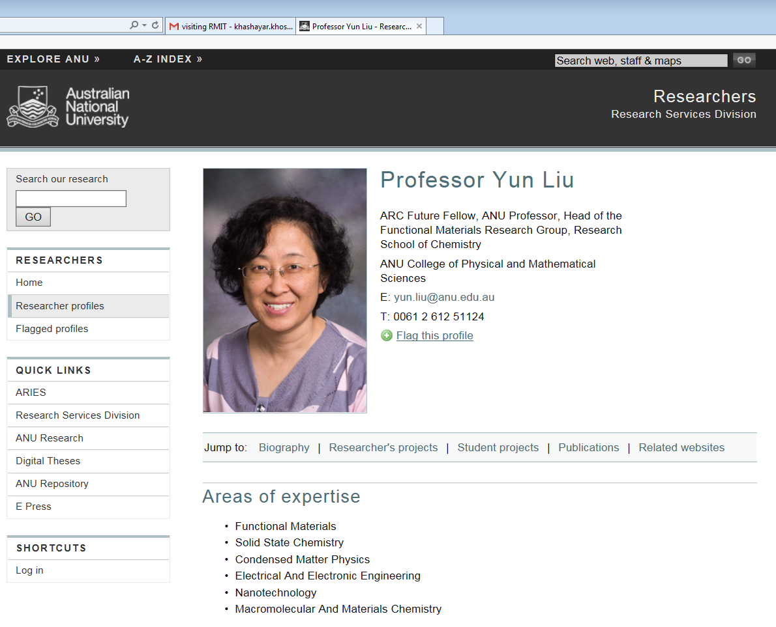
Let’s take a look at Google Scholar
You can go to their home page …..
RMIT University© 2019
francisco.tovarlopez@rmit.edu.au

Slide 28
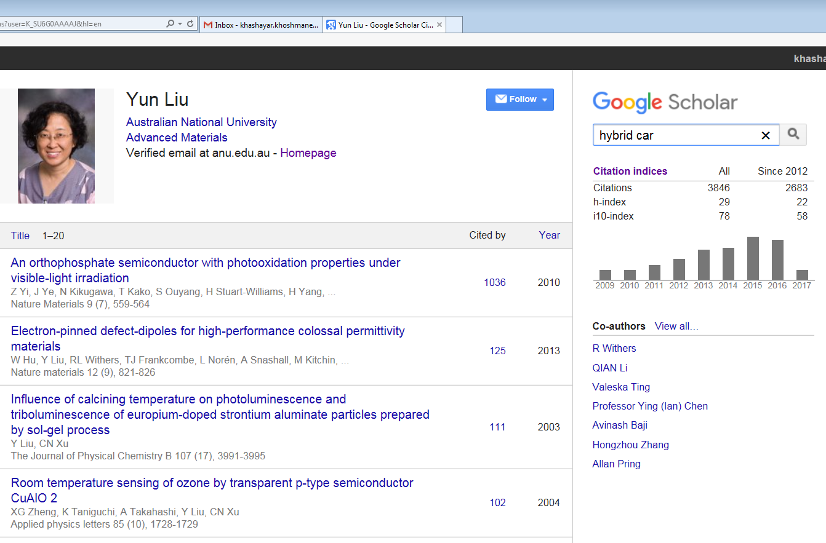
Let’s take a look at Google Scholar
OK, let’s find some people working on hybrid cars
RMIT University© 2019
francisco.tovarlopez@rmit.edu.au

Slide 29
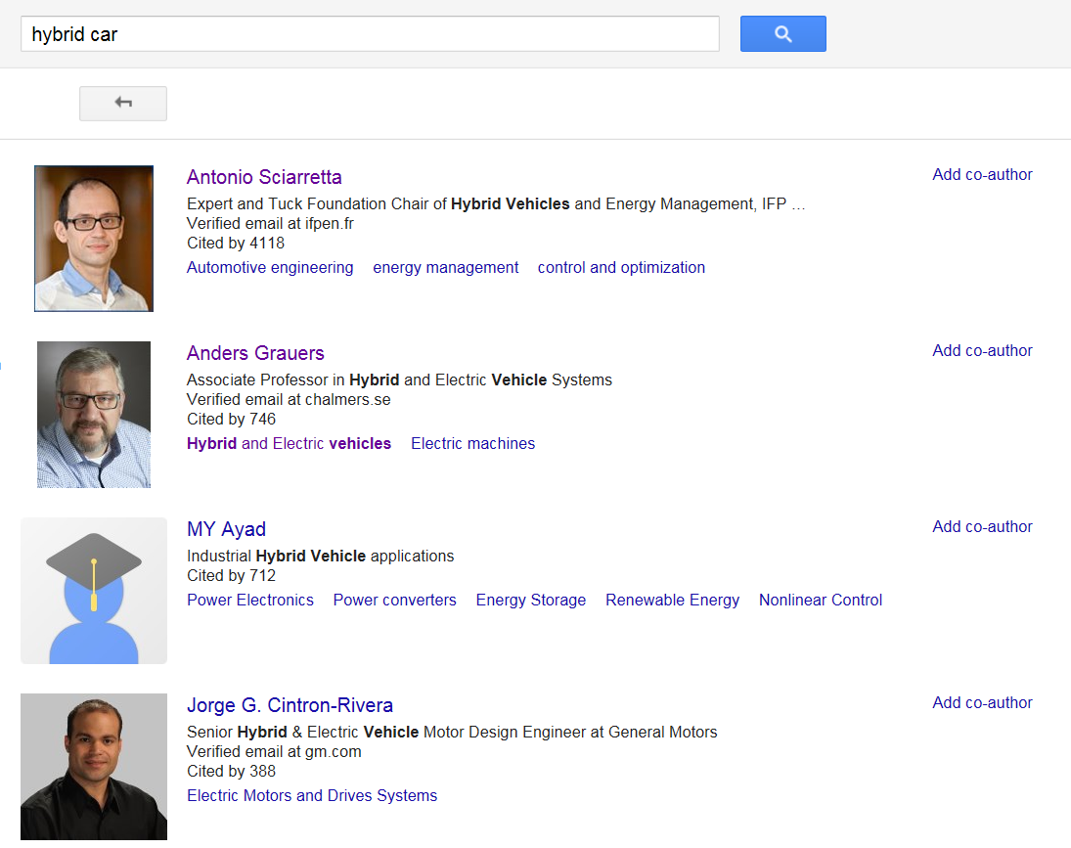
Let’s take a look at Google Scholar
We found four researchers who are ranked according to the number of their citations
RMIT University© 2019
francisco.tovarlopez@rmit.edu.au

Slide 30
Assignment 1 deadline is approaching ….
Dear Research Methods (EEET2449) students
This is your Assignment-1 (Literature Review), which should be submitted by 23:59 Friday, 30th August 2019.
Please choose a research topic from the lists provided to you or come up with your favourite topic.
Please use the attached template to prepare your 'Literature Review' Assignment: Assignment 1 template and instructions.docx
Please do not exceed the two-page limit. This also includes references.
This assignment should be submitted via Canvas in PDF format only.
You can find the rubric for Assignment-1 in the following file:
Rubric for Assignment 1--2019.xlsx
RMIT University© 2019
francisco.tovarlopez@rmit.edu.au

